Slide 1
Lesson Plan – Invasive Species
Summary
This lesson will define the term invasive species and explain the ecological consequences when foreign species are introduced into a system. Students will be introduced to examples of invasive species that are now permanent organisms in our ecosystems. The lesson will also address measures to mitigate negative impacts of invasive species and how to prevent additional invasive species from establishing in our ecosystems.
Content Area
Ecology, Marine Biology
Grade Level
3-5
Key Concept(s)
Invasive species are organisms introduced into an ecosystem that are not native to that ecosystem.

Slide 2
Lesson Plan – Invasive Species
Key Concept(s)
Invasive species can have devastating effects on the ecological balance of an ecosystem. They can outcompete and consume native species and reduce the biodiversity in an ecosystem.
Some invasive species are more damaging to native ecosystem that others.
Many species that you may encounter everyday are invasive species.
Invasive species can impact economical resources and cost millions in damage and control.
You can take steps to reduce the negative impact of invasive species and prevent new invaders from entering our ecosystems.
Objectives
Students will be able to:
Define invasive species.
Name three examples of invasive species that affect their local and/or regional ecology.
Explain one example how invasive species cause damage to existing native ecosystems.

Slide 3
Lesson Plan – Invasive Species
Objectives
Students will be able to:
Name two ways they can help reduce the negative impact of invasive species and prevent the introduction of native species into our ecosystems.
Resources
Ecological information, species profiles, and regulations
https://www.invasivespeciesinfo.gov/aquatics/main.shtml
National Wildlife Federation: Information, species, how to help
http://www.nwf.org/Wildlife/Threats-to-Wildlife/Invasive-Species.aspx
GCOOS Lionfish and Tiger Shrimp interactive maps
https://bit.ly/3bSbxLi
https://bit.ly/39J4X84

Slide 4
Lesson Plan – Invasive Species
National Science Education Standard or Ocean Literacy Essential Principle | Learning Goals
Unifying Concepts and Processes 2. Evidence, models, and explanation | Evidence consists of observations and data on which to base scientific explanations. Using evidence to understand interactions allows individuals to predict changes in natural and designed systems.
Unifying Concepts and Processes 3. Change, constancy, and measurement | Changes might occur, for example, in properties of materials, position of objects, motion, and form and function of systems. Interactions within and among systems result in change. Changes vary in rate, scale, and pattern, including trends and cycles.
Science as Inquiry A.1. Abilities necessary to do scientific inquiry Ask a questions about objects, organisms, and events in the environment. | This aspect of the stan- dard emphasizes students asking questions that they can answer with scientific knowl- edge, combined with their own observa- tions. Students should answer their ques- tions by seeking information from reliable sources of scientific information and from their own observations and investigations.

Slide 5
Lesson Plan – Invasive Species
National Science Education Standard or Ocean Literacy Essential Principle | Learning Goals
Life Science C.1. Characteristics of organisms | Organisms can survive only in environments in which their needs can be met. The world has many different environments, and distinct environments support the life of different types of organisms.
Life Science C.3. Organisms and their environments | All organisms cause changes in the environment where they live. Some of these changes are detrimental to the organism or other organisms, whereas others are beneficial.
Science in Personal and Social Perspectives F.4. Changes in environments | Changes in environments can be natur- al or influenced by humans. Some changes are good, some are bad, and some are neither good nor bad. Some environmental changes occur slowly, and others occur rapidly.

Slide 6

Lesson Plan – Invasive Species
National Science Education Standard or Ocean Literacy Essential Principle | Learning Goals
Principle 6 (3-5 C., C.7., C.10.) The ocean and humans are inextricably interconnected Human impact on the ocean. | C. Humans impact the ocean in positive and negative ways. C.7. Individuals can take actions to protect the ocean. C.10. Everyone can learn and influence other people about the wise use and protection of the ocean.

Slide 7
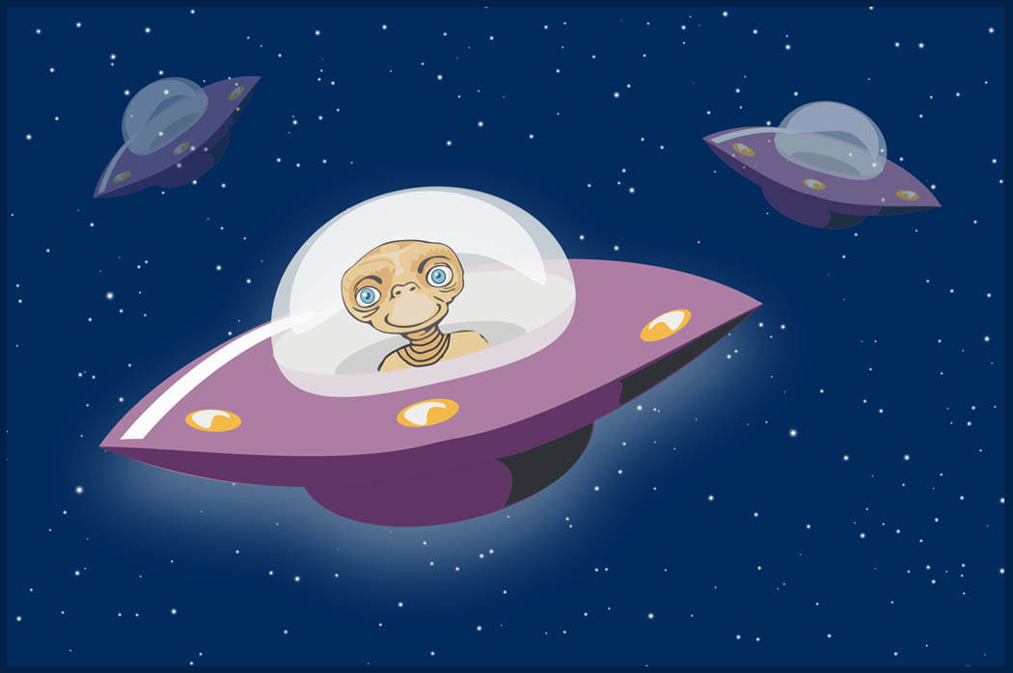
Invasive Species
No, not aliens from outer space!

Slide 8
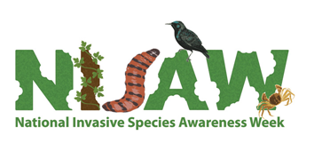
Invasive species are plants and animals that do not naturally occur in an area.
They are also called NON-NATIVE or EXOTIC species.

Slide 9
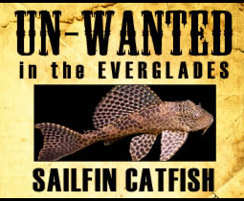
Invasive Species in Florida
More than 500 non-native animals
More than 1,180 non-native plants
Why are they bad?
Out-compete native species
Destroy habitat
Carry diseases

Slide 10
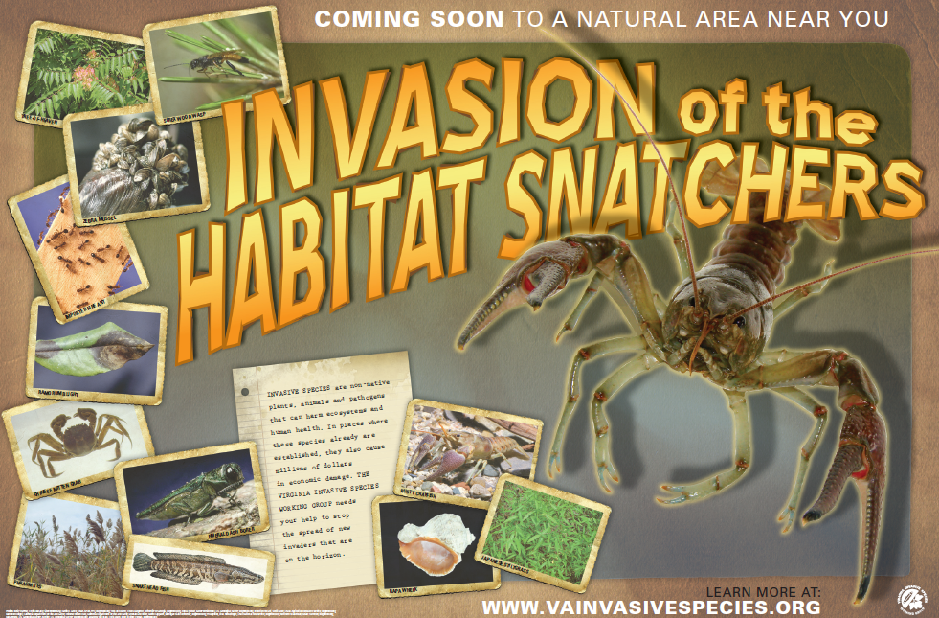

Slide 11
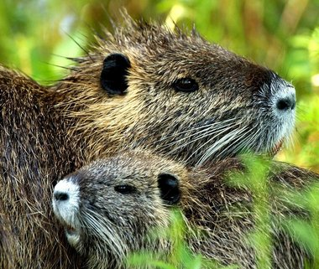
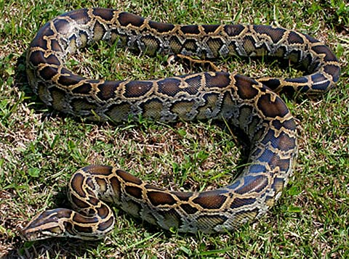
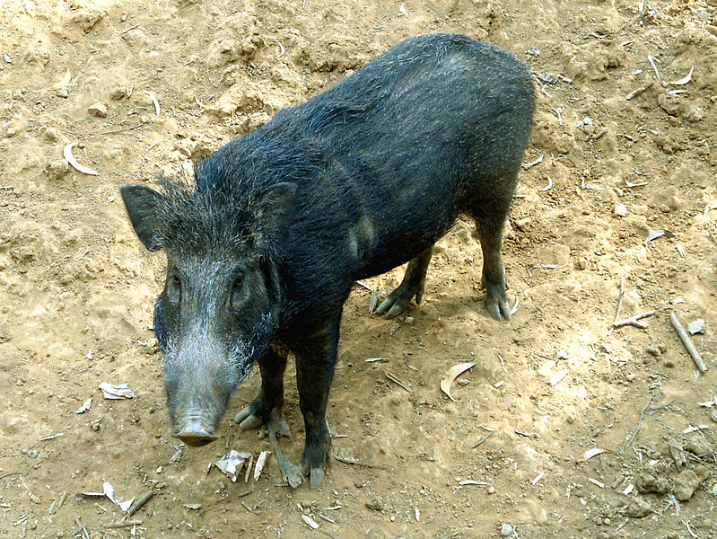
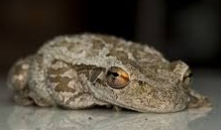
Some of Florida’s Invasive Animals
Nutria
Python
Wild Boar — Europe
Cuban Tree Frog

Slide 12
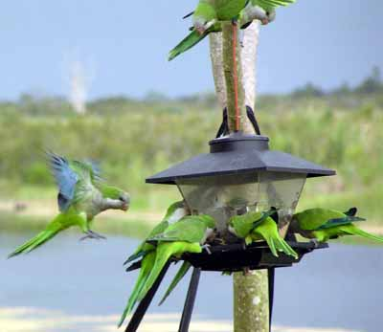
Monk or Quaker Parakeet
(South America)

Slide 13
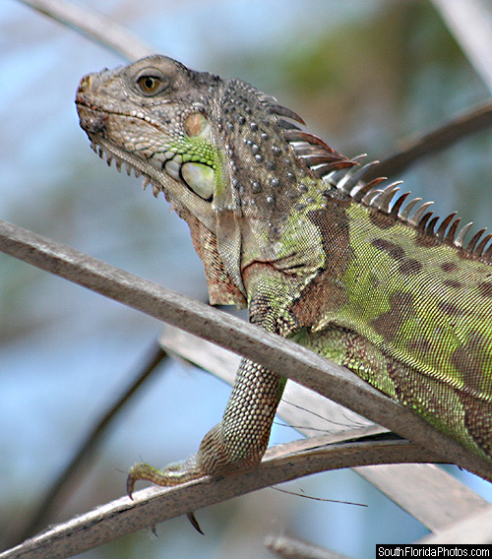
Iguanas
Central and South America

Slide 14
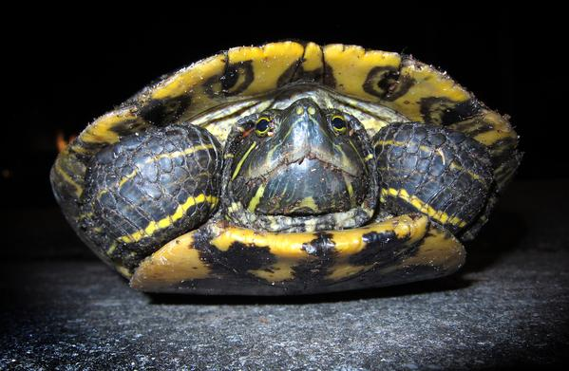
Red-eared slider
Mississippi River Area

Slide 15
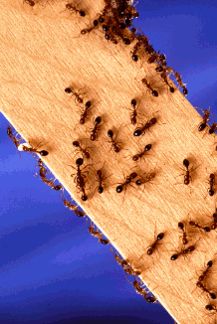
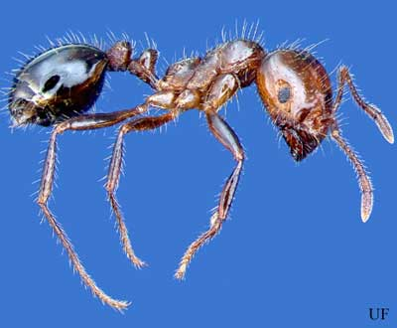
Fire ants
Native to Central and South America

Slide 16
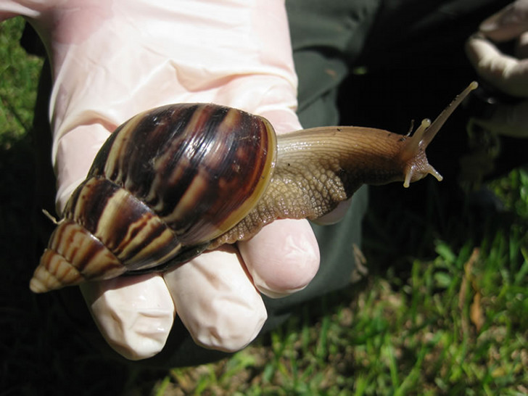
Giant African Land Snail

Slide 17
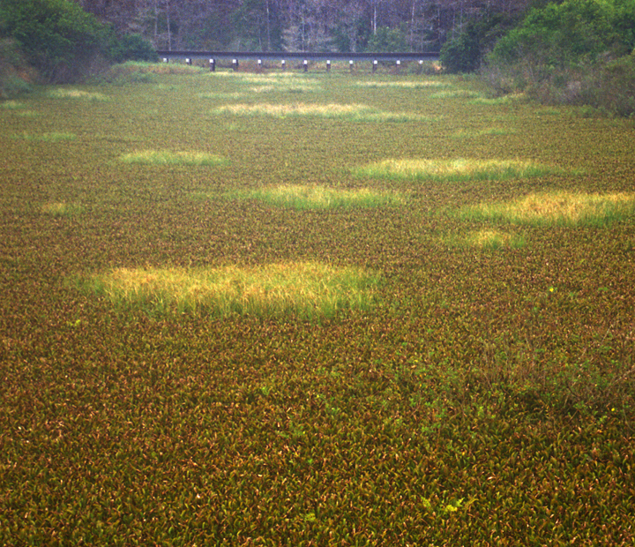
Water Hyacinth
(South America)

Slide 18
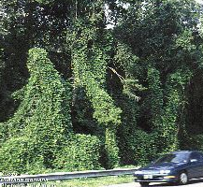
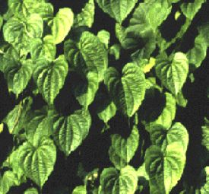
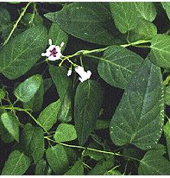
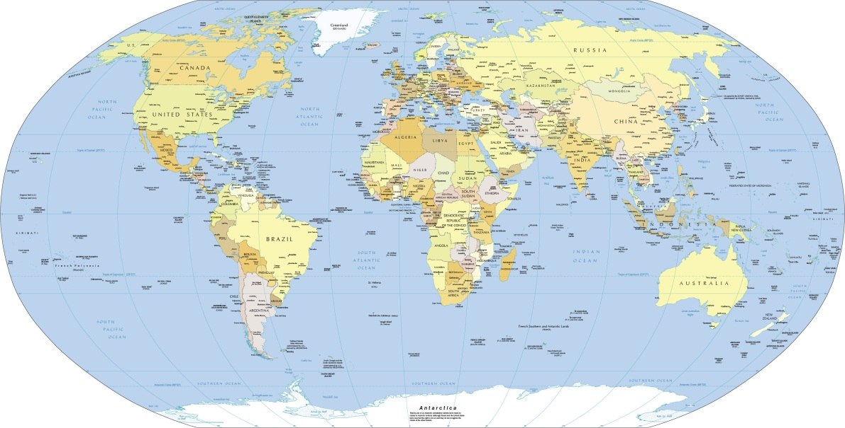
Kudzu Air Potato Skunk Vine
You
are
here!
All originated
in Asia

Slide 19
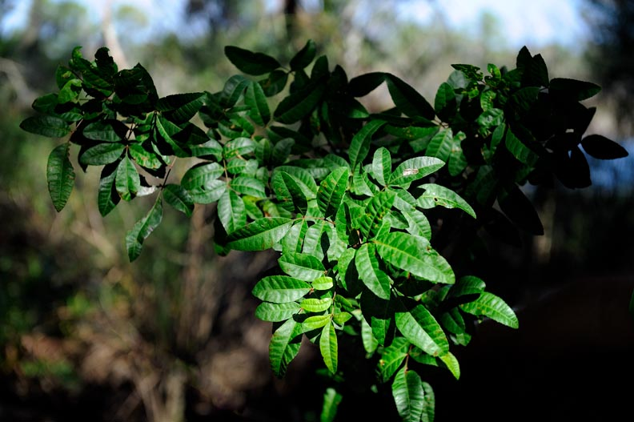
Brazilian Pepper

Slide 20
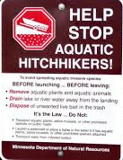
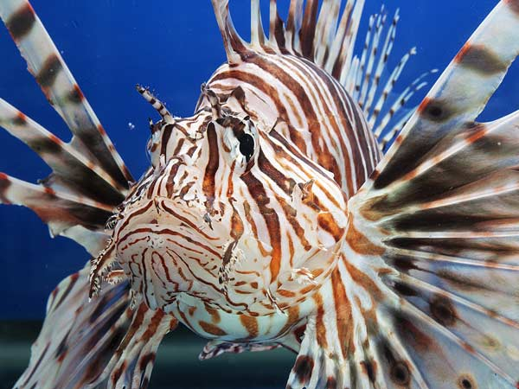

Slide 21
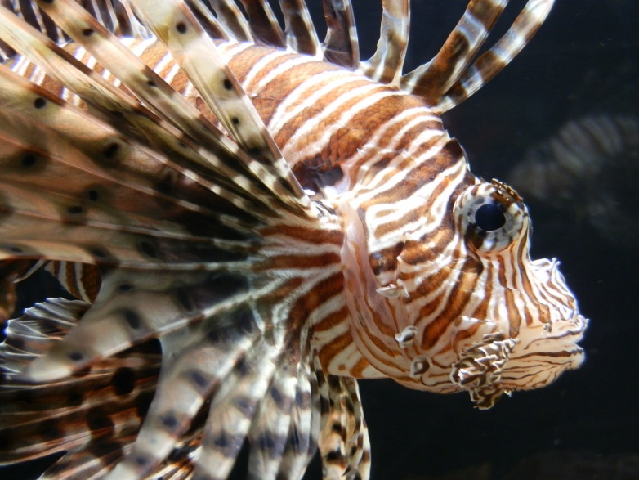
How has the red lionfish spread throughout the Gulf of Mexico?
The Gulf of Mexico Coastal Ocean Observing System created a time series map to show how lionfish are invading the Gulf of Mexico and Caribbean Sea.
https://bit.ly/39J4X84

Slide 22
Activity – Invasive Species
This activity will demonstrate to students what happens when an invasive species with no natural predators is introduced into an ecosystem. Some of the negative effects invasive species can have on ecosystems include predation or displacement of native species, a reduction in biodiversity, and an upset in the balance and/or structure of the ecosystem.
Materials
Styrofoam board (from packaging) or foam crafts board
Pipe cleaners (four different colors besides red); 10 each of 4 colors (can be cut pieces)
Craft pompom balls (same four colors as pipe cleaners); 12 each of 4 colors
Red pipe cleaners (Lionfish)

Slide 23
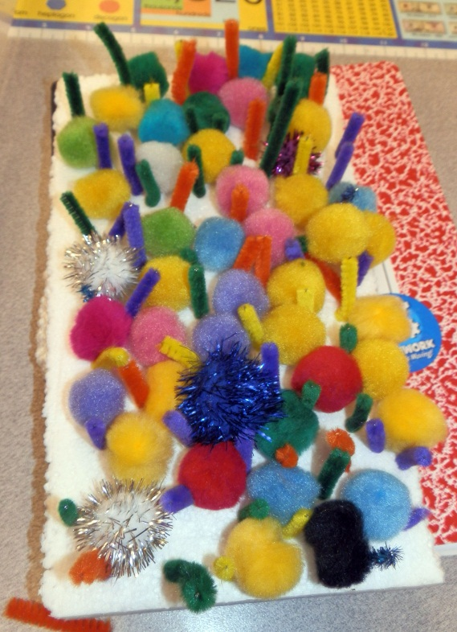
What will we do?
Build an ecosystem
Introduce an invasive species
Obliterate your ecosystem!
Note: a colorful ecosystem
has a lot of biodiversity
(variety of life). It is a good sign of a healthy environment!

Slide 24
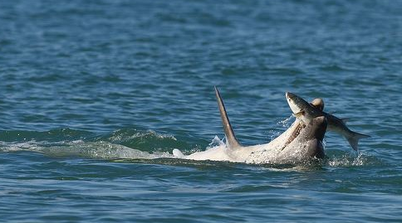
Build your ecosystem
Use 10 each of four different color pipe cleaners to make a healthy ecosystem. Each color represents a species in your system.
Place 12 each of four different color pompoms (same colors as your pipe cleaners) on the board. Each pompom represents food for the species that has the same pipe cleaner color
For example, if you use a blue pipe cleaner to represent a bottlenose dolphin, than a blue pompom might be a favorite fish (e.g., sardines, anchovy, mullet).

Slide 25
Invasive Species Attack!
Red pipe cleaners represent our invasive species (lionfish).
Each round, I will tell you how many invasive lionfish (red pipe cleaners) to add.
Every time you add lionfish, you must remove at least that many pompoms of the color or colors I call.
Sometimes it will be the same number of pompoms and other times it will be more pompoms (because lionfish have voracious appetites! Also, the invasive species can directly ‘eat’ a pipe cleaner of another color!
When ALL the pompoms of a particular color are ‘eaten’ by the invasive species, you must remove all the pipe cleaners of that color from the Styrofoam board (no food=death!)
Who will have the last non-invasive species on their Styrofoam board?

Slide 26
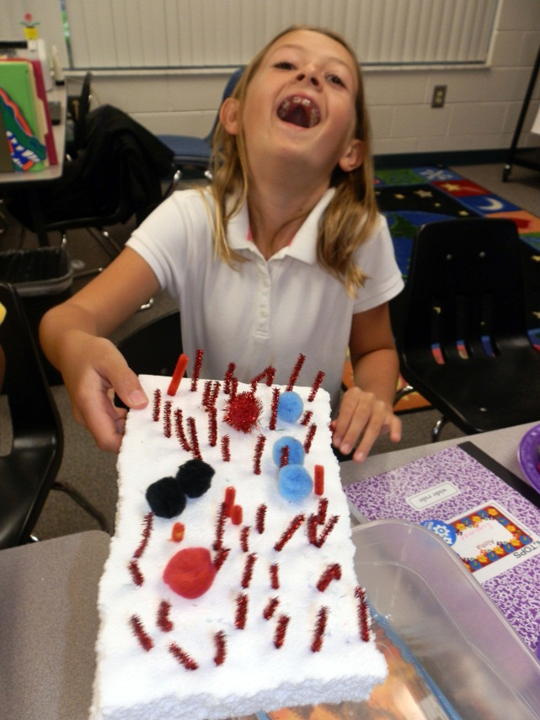
Ecosystem Obliterated!
Biodiversity will eventually disappear and you will be left with only invasive species.

Slide 27
Some of the Gulf’s threatened and endangered species
Invertebrates
  Coral: Acropora cervicornis (Staghorn Coral), Acropora palmata (Elkhorn Coral)
Birds
  Bald eagle, Mississippi sandhill crane, whooping crane, piping plover, brown pelican
Sea turtles
  Kemp’s Ridley, Green, Hawksbill, Leatherback and Loggerhead turtles
Mammals
  Marine: Blue , Fin, Humpback, Minke, Sperm, Sei, and Right whales; West Indian Manatee
  Terrestrial: AL beach mouse, FL panther, FL salt marsh vole, LA black bear, Perdido Key beach mouse, puma
Fish
  Nassau grouper, Gulf sturgeon ,smalltooth sawfish

Slide 28
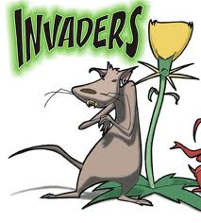
What will you do to keep
out the invaders?

Slide 29
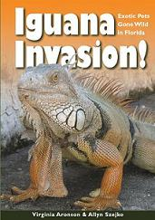
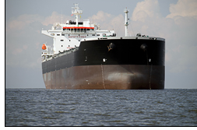
How can you minimize the unintentional introduction of invasive species?
Maritime Industry
  Ballast water
  Transport on the hulls of ships
Escape from fish farms
Opening of canals and waterways
Use of live bait
Release from aquariums/homes
Release from fish trade/fish stocking
Recreational boating
Transport of agricultural products
Exotic pet trade industry

Slide 30

Acknowledgements
Lesson developed by Dr. Chris Simoniello for Bay Point Elementary. Standards-cross-referencing and formatting by Grant Craig.
Questions, comments, edits? Contact Dr. Chris: chris.Simoniello@gcoos.org

