Slide 1
Lesson Plan – Atoms and Water Molecules
Summary
This lesson and activity will help students understand what atoms and elements are and how they are the building blocks of matter. Students will create a water molecule to demonstrate how atoms and elements build molecules and matter.
Subject Area
Chemical Science/ Oceanography
Grade Level
1-2

Slide 2
Lesson Plan – Atoms and Water Molecules
Key Concepts
Atoms are the smallest parts or “building blocks” of elements, molecules, and matter.
The Periodic Table of Elements is all of the atoms and elements (and their properties) currently known to scientists.
The atoms is made up of three parts: protons, neutrons, and electrons
Water is made up of 2 Hydrogen atoms and 1 Oxygen atom and has very unique properties.
Objectives
Students will be able to:
Understand that atoms are the smallest components of elements, molecules, and matter
Understand that the periodic table of elements is a list of all the atoms/ elements known to scientists
Name the parts of an atom
Name two characteristics unique to the water molecule

Slide 3
Lesson Plan – Atoms and Water Molecules
National Science Education Standard or Ocean Literacy Essential Principle | Learning Goals
Unifying Concepts and Processes 1. Systems, order, and organization | Types of organization provide useful ways of thinking about the world.
Unifying Concepts and Processes 2. Evidence, models, and explanation | Models help scientists and engineers understand how things work.
A.1: Abilities necessary to do scientific inquiry | Ask a question about objects, organisms, and events in the environment.
B.1: Properties of objects and materials | 1. Objects have many observable properties, including size, weight, shape, color, temperature, and the ability to react with other substances. 2. Materials can exist in different states— solid, liquid, and gas.

Slide 4
Lesson Plan – Atoms and Water Molecules
National Science Education Standard or Ocean Literacy Essential Principle | Learning Goals
D.1: Properties of earth materials | Earth materials are solid rocks and soils, water, and the gases of the atmosphere. The varied materials have different physi- cal and chemical properties, which make them useful in different ways
Principle 1 (K-2:A): Earth has one big ocean with many features. | Ocean water has unique properties.

Slide 6
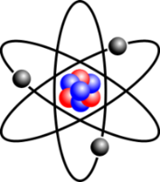
Think of making molecules from atoms like building words with letters.
We sort letters into two groups:
“I just don’t get that guy. Sometimes he sits with us, sometimes he doesn’t!”

Slide 7
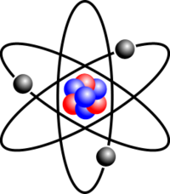
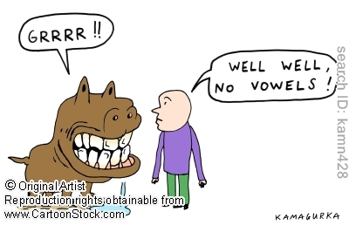
Think of making matter from molecules and atoms like building sentences with words and letters.

Slide 8
Before we build a molecule from atoms, we will build a sentence from letters and words!

Slide 9
All matter is made from atoms!
The word "atom" comes from the Greek word indivisible
When we say the Pledge of Allegiance, we say
“…one nation under God, INDIVISIBLE, with liberty and justice for all.”
What we really mean is that it can’t be
divided or separated into smaller parts.

Slide 10
The “alphabet” for atoms is the Periodic Table
There are 26 letters in the alphabet. There are about 115 elements in the language of chemistry. It changes as we make discoveries!

Slide 11
Atoms make up elements--the building blocks of matter
The building blocks are too small to see, even with a light microscope.
In 1981, the Scanning Tunneling
Microscope was invented. It
uses electric currents to ‘see’
atoms.

Slide 12
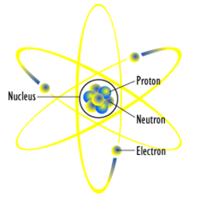
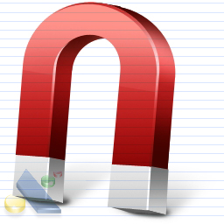
The atom is made up of 3 parts
1) Proton
Protons have a POSITIVE charge.
2) Neutron
Neutrons have NO charge.
3) Electron
Electrons have a NEGATIVE charge.
Electrons are by far the smallest. We do not yet have the technology to measure their mass and size.
Most atoms have a neutral charge because the number of protons and electrons are the same.

Slide 13
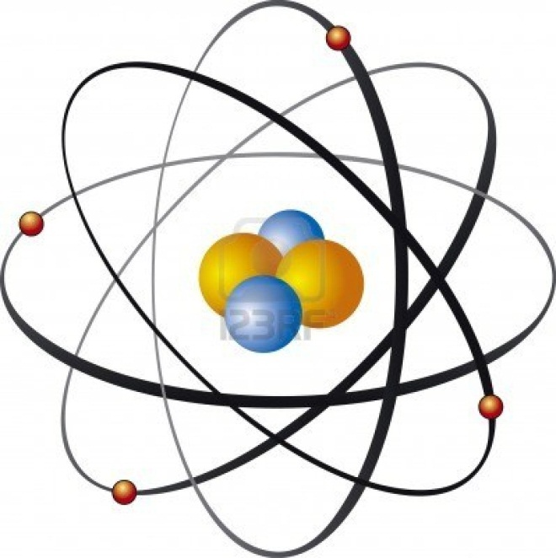
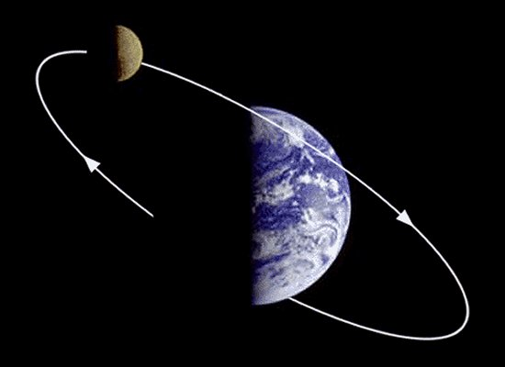
Electrons orbit the nucleus like the moon orbits Earth
The place where electrons are found are called orbitals.
In each orbital, there can only be a certain number of electrons.
The negative charge of electrons is attracted to the positive charge of the protons.
This is why we say ‘opposites attract’!

Slide 14
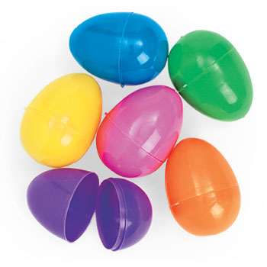
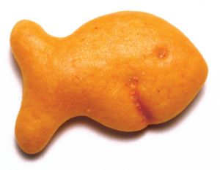
Protons and neutrons are in the nucleus
Protons and neutrons are about the same size.
They are in the ‘middle’ of the atom, or the nucleus.
We will put our protons (goldfish) and neutrons
(gummies) in our nucleus (plastic egg)
When the number of protons and neutrons is equal, the nucleus is stable—it stays the way it is.
When there is more of one than the other, the atom tries to make the numbers the same by getting rid of the extra parts.

Slide 15
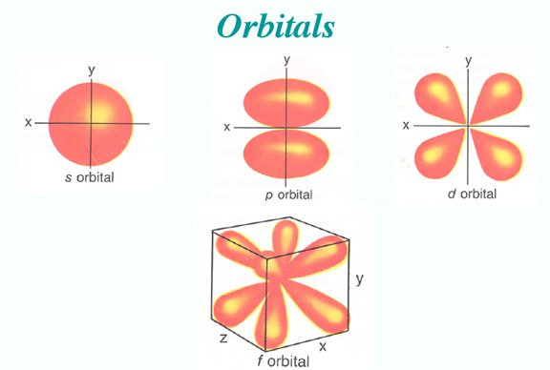
Electrons
Around the nucleus some electrons are further out than others.
The further away the electron is from the nucleus, the weaker the pull of the nucleus on it. This is why bigger atoms, with more electrons, react more easily with other atoms.

Slide 16
The number of protons and electrons determine the kind of element.

Slide 17
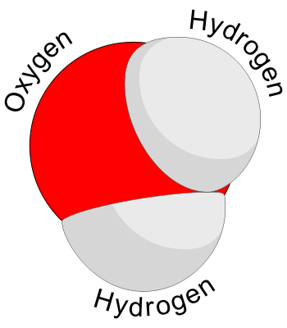
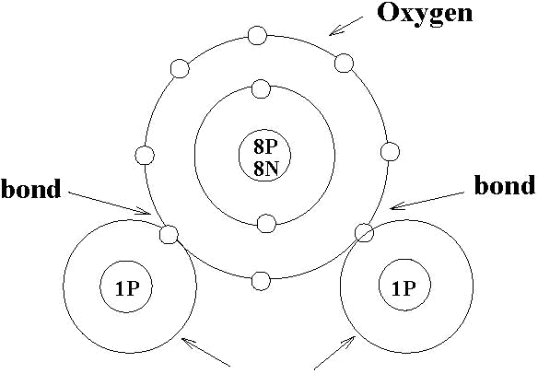
Water is the most amazing molecule!
Hydrogen is the only element without a neutron. It has 1 proton and 1 electron.
Oxygen has 8 protons, 8 neutrons and 8 electrons.
Hydrogen and oxygen form water when 2 Hydrogen atoms share 2 electrons with 1 Oxygen atom.

Slide 18
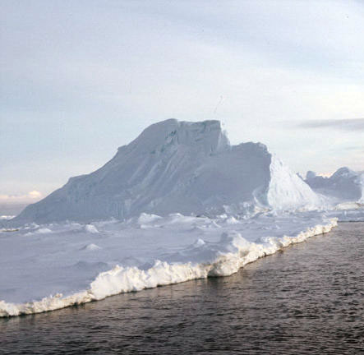
Only water…H2O
Water in its solid state is less dense than its liquid state.
Solid ice floats on liquid water!
Water expands when it turns solid.
Most molecules shrink together or compress.
Ice is less dense than liquid water because of the way the atoms line up and bond together!

Slide 19
Activity
Mostly Edible Water Molecule
Step by Step: Let’s make a water molecule
Materials
Plastic Easter eggs
Small (smaller than the plastic eggs) plastic spheres (similar to those found in prize machines)
Play dough or modeling clay
Toothpicks
Goldfish crackers
Raisins

Slide 20
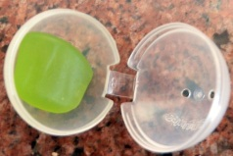
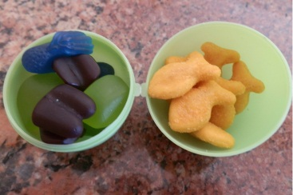
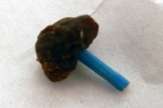
Step by Step: Let’s make a water molecule
Put 1 goldfish (proton) in the first small sphere and close.
Put 1 goldfish in the second small sphere and close.
These are your Hydrogen atoms without their electrons.
3. Put 8 goldfish and 8 gummies (neutrons) in your plastic egg.
Close it carefully. This is your Oxygen atom without its electrons.
4. Attach one raisin (electron) to the end of a broken toothpick.

Slide 21
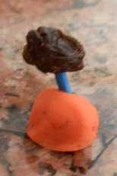
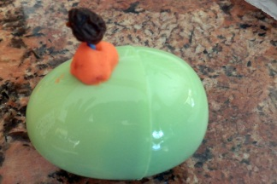
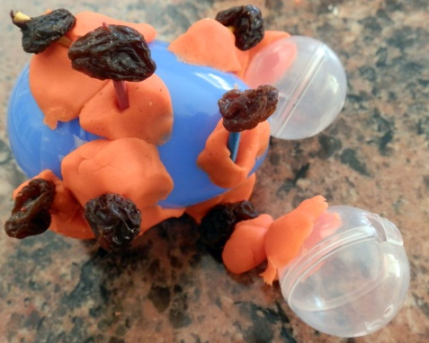
5. Do this again for the other 7 raisins and toothpicks. These are the electrons in the outer orbital (6 for oxygen and 1 for each hydrogen).
6. Use Play Dough to stick 6 toothpicks with
raisins to the outside of the plastic egg.
7. Stick the remaining two toothpicks with raisins
on the Hydrogen atoms.
8. Try your best to attach the two Hydrogen spheres
to the plastic egg. Use more Play Dough if you need.
In a water molecule, each Hydrogen atom shares its only electron
with an Oxygen atom.

Slide 22
Acknowledgements
Lesson developed by Dr. Chris Simoniello for Bay Point Elementary 1st Grade. Standards-cross-referencing and formatting by Grant Craig.
Questions, comments, edits? Contact Dr. Chris: chris.Simoniello@gcoos.org

